Slide 1
Welcome
Thanks for Joining Us for a special
Balanced Approach to Senior Wellness Presentation
^{Todays’ Topics to include:}
Is there an increased risk of COVID-19 for those with Arthritis?
Why is there an increase in complaints about Arthritis pain since March 2020?
^{Exercising in a pandemic}
Benefits of exercise for Arthritis sufferers
Recommended types of exercise for Arthritis
^{Tips to protect your joints}

Slide 2
It’s a sign of the times that we have to begin this presentation with this important information regarding arthritis:
Is There An Increased Risk of COVID-19 for Those With Arthritis?
^{Osteoarthritis:}
The most common type, osteoarthritis, seems in the clear when it comes to the coronavirus. A few months ago, scientists were worried that people taking common arthritis medications known as nonsteroidal anti-inflammatory drugs (NSAIDs) — a category that includes aspirin, ibuprofen, Aleve and selective COX2 inhibitors like Celebrex and Vioxx — could have an elevated risk of contracting the disease. This was based on a theory that the increase of an enzyme in the lungs from the drugs might create a welcome mat for the virus.
Even so, you might want to switch or take NSAIDs at the lowest dose that helps, advises Lee Rubin, M.D., chief of the Total Joint Replacement Program at Yale Medicine.
https://www.aarp.org/health/conditions-treatments/info-2020/coronavirus-and-arthritis.html

Slide 3
Autoimmune forms of Arthritis:
Rheumatoid & Psoriatic
The CDC specifically lists being on immunocompromising drugs as a factor that elevates your risk of COVID-19 complications.
The reason: The drugs make it harder for your body to mobilize immune cells to fight the disease.
American College of Rheumatology (ACR) and the National Psoriasis Foundation recommend that if you are exposed to or develop COVID-19, you should temporarily stop immunosuppressant pharmaceuticals like cyclosporine, CellCept, Enbrel or Humira.
Doctors do not recommend stopping these drugs if you don't have any known exposure to the coronavirus. Uncontrolled inflammation from rheumatoid arthritis can make you susceptible to other health problems.
https://www.aarp.org/health/conditions-treatments/info-2020/coronavirus-and-arthritis.html

Slide 4
?
This being said, what do you suppose is the reason doctors around the world are seeing an increase in arthritis-induced pain complaints from patients?

Slide 5
LACK OF EXERCISE
Due to the isolating factors of the current pandemic situation, seniors are spending more time alone on the sofa and less time physically active.
Answer:

Slide 6
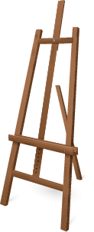
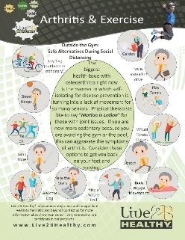
Exercising Outside the Gym Just because the gym is closed or your trainer is not able to come out to your community in person, does not mean that you can’t stay physically active. Many of our communities are making our LIVE Virtual classes available to their residents (ask us how you can participate from the safety of your own home). The following are some ideas for the rest of the week to keep you from getting sedentary.
Presenter: Please hand out the Outside the Gym handout.

Slide 7
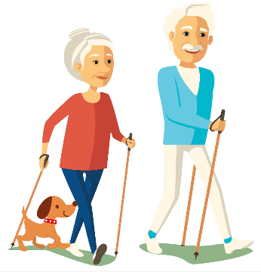
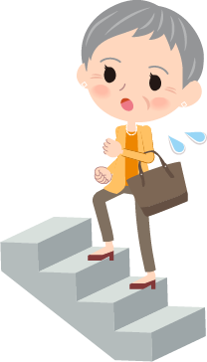
Let’s brainstorm how the activities found on the Outside the Gym handout could help you relieve arthritis pain.
Can you think of others to add to the list?

Slide 8
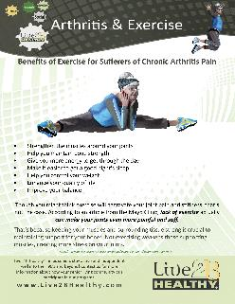
Presenter: Please hand out the Benefits of Exercise handout.
Though you might think exercise will aggravate your joint pain and stiffness, that's not the case. Lack of exercise actually can make your joints even more painful and stiff.
That's because keeping your muscles and surrounding tissue strong is crucial to maintaining support for your bones. Not exercising weakens those supporting muscles, creating more stress on your joints.
Source: https://www.mayoclinic.org/diseases-conditions/arthritis/in-depth/arthritis/art-20047971

Slide 9
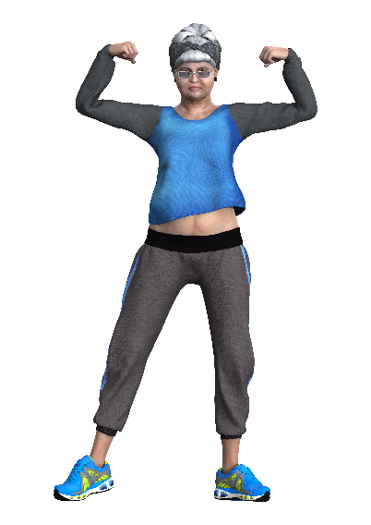
Exercise helps mitigate the pain and stiffness of arthritis by:
Strengthen the muscles around your joints
Help you maintain bone strength
Give you more energy to get through the day
Make it easier to get a good night's sleep
Help you control your weight
Enhance your quality of life
Improve your balance
Source: https://www.mayoclinic.org/diseases-conditions/arthritis/in-depth/arthritis/art-20047971

Slide 10
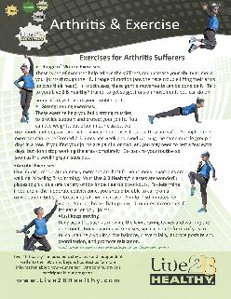
Presenter: Please hand out the Exercises for Arthritis handout.
Now that we know that exercise is beneficial to those who suffer from the pain of arthritis – and, as an added bonus, helps you to build your immune system – what type of exercise is recommended?
We’ll give you a hint – you’ll be happy to hear that it’s not running!

Slide 11
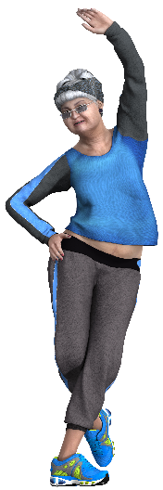
These types of exercises help relieve the stiffness and increase your ability to move your joints through their full range of motion (anyone have trouble lifting their arms up over their head). In most cases, these gentle movements can be done daily. Talk to your Live 2 B Healthy® trainer to get suggestions on movements you can do on non-class days to work your trouble spots.
Range of Motion Exercises

Slide 12
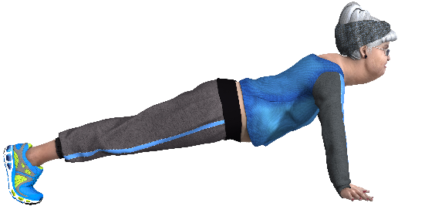
These exercise help you build strong muscles to provide support and protect your joints. You can use weights, but often in our classes, we use bands and loops or simply body-weight exercises because they are safer. Strengthening exercises can be performed 2-3 times per week and avoid working the same muscle group 2
Strengthening Exercises
days in a row. If you find your joints are painful or swollen, you may need to rest a few extra days, but don’t stop working the area completely. Go back to your routine as soon as the swelling/pain subsides.

Slide 13
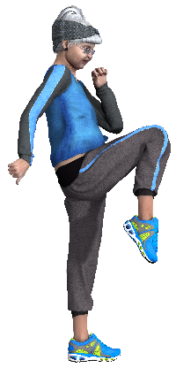
Low impact, moderate intensity exercises are best for your joints. Examples are walking, bicycling & swimming. Your Live 2 B Healthy® classes are wonderful places to pick up a safe variety of low impact aerobic workouts. To determine if you are in the moderate activity zone, you should be able to carry on a conversation, but your breathing rate will increase. Aim for 150 minutes per week. You can break that up into 10 minutes increments if it’s easier on your joints.
Aerobic Exercises

Slide 14
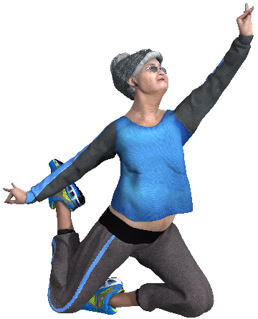
Just Keep MOVING!
Daily activities such as mowing the lawn, raking leaves and walking the dog count.
Body awareness exercises, such as gentle forms of yoga or tai chi, can help you improve balance, prevent falls, improve posture and coordination, and promote relaxation.

Slide 15
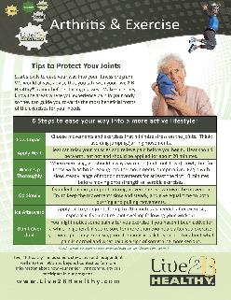
Presenter: Please hand out the Tips to Protect Joints handout.
6 Steps to Ease Into a More Active Lifestyle:
Low Impact
Apply Heat
Warm Up Thoroughly
Go Slowly
Ice Afterward
Don’t Over-do It
If you have rheumatoid arthritis, ask your doctor if you should exercise during general or local flares. One option is to work through your joint flares by doing only range-of-motion exercises, just to keep your body moving, or exercising in water to cushion your joints.

Slide 16
Insert Community Logo here
Our community offers FREE senior fitness classes on
Monday, Wednesday & Friday at 11:00 am.
We hope you will join us and see for yourself how beneficial fitness is to your overall well-being!

Slide 17
Now it’s your turn…
Questions?
Comments?
Concerns?

Slide 18
Thank You for Attending Our Presentation!
For more information, or to schedule senior fitness classes, or other educational opportunities in your Senior Living Community, please contact:
Put your contact information here

